Slide 1
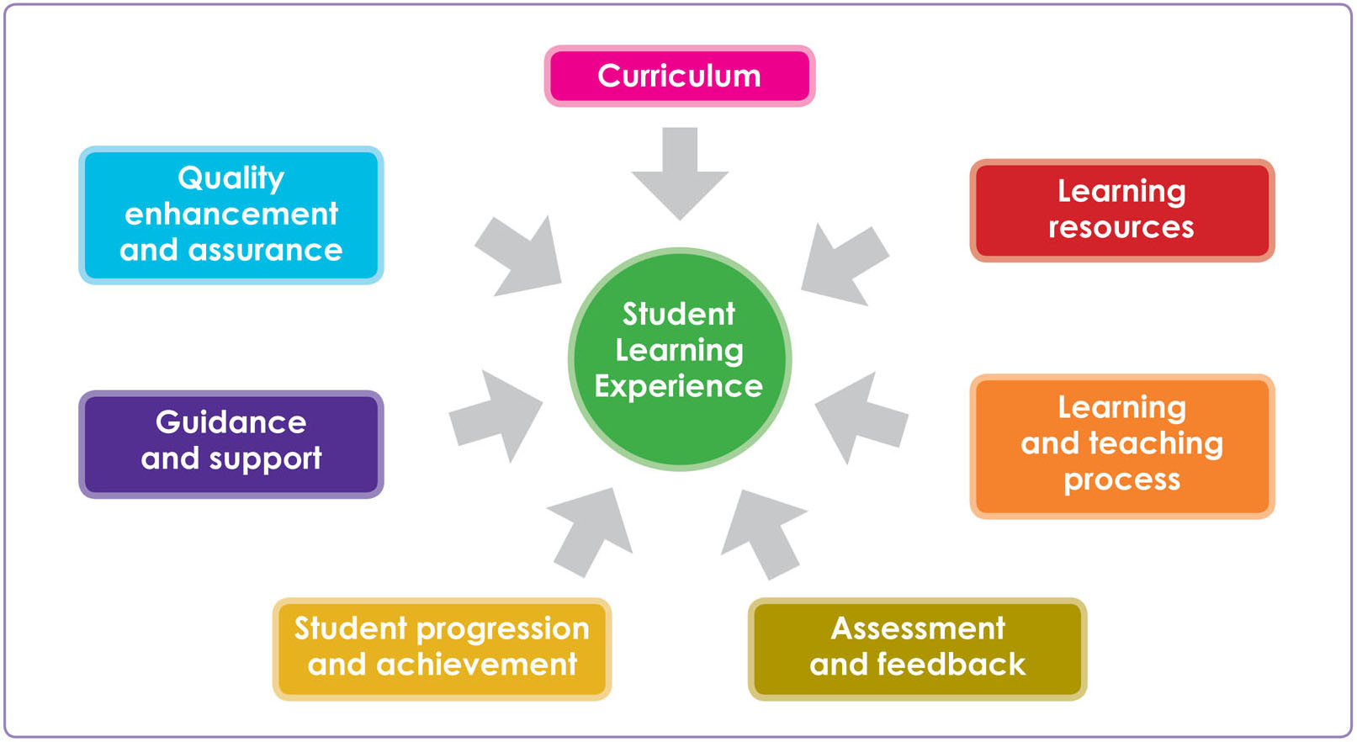
Student Learning Experience

